Slide 1
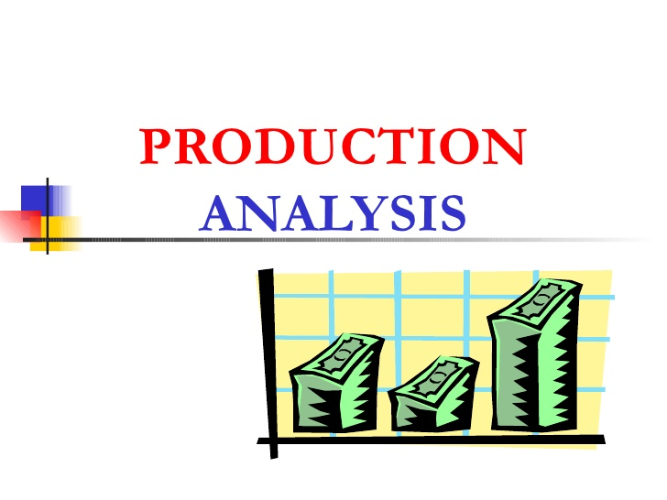

Slide 2
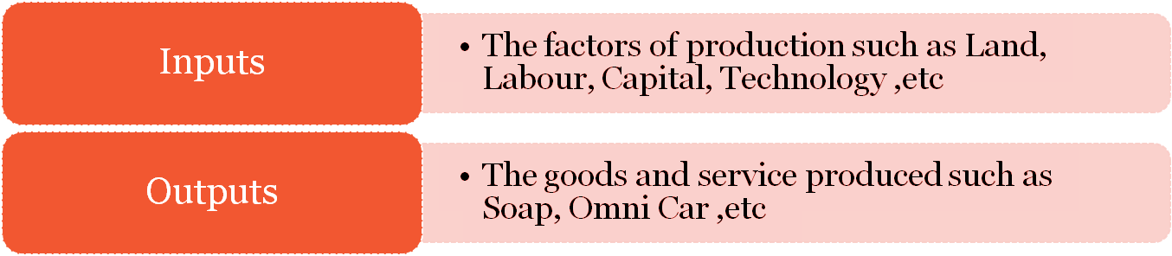
Production is a process that create/adds value or utility
It is the process in which the inputs are converted in to outputs.

Slide 3
Production Function
Production function means the functional relationship between inputs and outputs in the process of production.
It is a technical relation which connects factors inputs used in the production function and the level of outputs.
The theory of production begins with some prior knowledge of the technical and/or engineering information. For instance, if a firm has a given quantity of labour, land and machinery, the level of production will be determined by the technical and engineering conditions and cannot be predicted by the economist.
The level of production depends on technical conditions. If there is improvement in the technique of production, increased output can be obtained even with the same (fixed) quantity of factors.
Q = f (Land, Labour, Capital, Organization, Technology, etc)

Slide 4
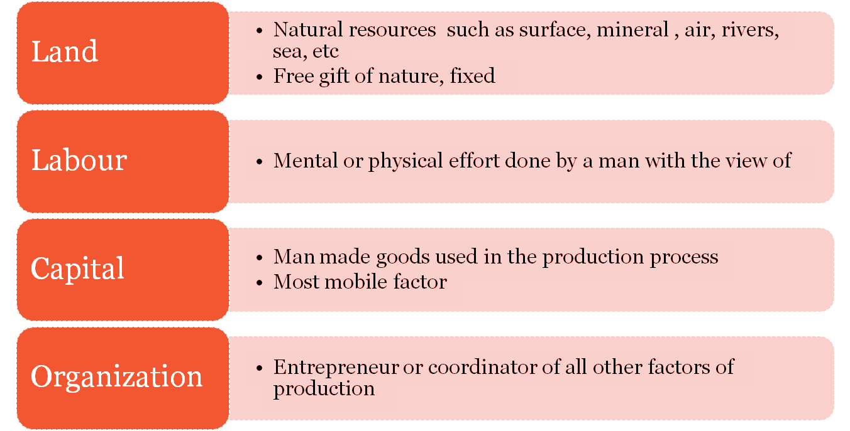
Factors of Production

Slide 5
Inputs : Fixed inputs and Variable inputs
The factors of production that is carry out the production is called inputs.
Land, Labour, Capital, Organizer, Technology, are the example of inputs
Inputs Factors
Variable inputs
Fixed Inputs

Slide 6
Fixed inputs Variable inputs
Remain the same in the short period .
At any level of out put, the amount is remain the same.
The cost of these inputs are called Fixed Cost
Examples:- Building, Land etc
( In the long run fixed inputs are become varies)
In the long run all factors of production are varies according to the volume of outputs.
The cost of variable inputs is called Variable Cost
Example:- Raw materials, labour, etc

Slide 7
Time period in which a firm is operating
The very short run:
A firm is said to be in its very short run when the only way to increase output is by using up existing stocks of inputs.
The short run:
A firm is said to be in its short run when it can increase its output by using more variable factors, such as by hiring more workers, but not by increasing its fixed factors. In the short run firms do not use extra fixed factors, such moving to new premises, to increase output. Therefore, in the short run at least one factor of production is fixed.
The long run:
A firm enters its long run when it increases its scale of operations. Increasing scale means that no factor of production is fixed, and all are variable. Typically, this means that a firm expands by building or renting larger premises, purchasing or leasing new machinery and employing more workers.
The very long run:
A whole industry enters the very long run when there is a significant change in the use of technology. For example, the widespread use of the internet to book holidays has drastically altered how the holiday industry is structured.

Slide 8
Time period for market operations
A whole market can also be considered in terms of the short and long run.
The industry short run
An industry is in its short run when its capacity is fixed. This usually means that the number of firms in the industry is fixed, with no new firms entering or leaving the market.
The Industry long run
This exists when there is an increase, or decrease, in the capacity of the industry to produce, and this usually means that the number of firms in a given market increases, or decreases.

Slide 9
Short Run Production Function
In short run production assumes there is at least one fixed factor input
Production function:
Shows the functional relationship between physical inputs (or factors of production) and output. It assumed inputs as the explanatory or independent variable and output as the dependent variable. Mathematically, we may write this as follows:
Q = f (L,K)
Here, ‘Q’ represents the output, whereas ‘L’ and ‘K’ are the inputs, representing labour and capital (such as machinery) respectively. Note that there may be many other factors as well but we have assumed two-factor inputs here.
The short-run production function defines the relationship between one variable factor (keeping all other factors fixed) and the output. The law of returns to a factor explains such a production function.

Slide 10
Long Run Production Function
In long-run production function all factors are varied in the same proportion. The law that is used to explain this is called the law of returns to scale. It measures by how much proportion the output changes when inputs are changed proportionately.

Slide 11
Total Product, Average Product and Marginal Product
Total Product
In simple terms, we can define Total Product as the total volume or amount of final output produced by a firm using given inputs in a given period of time.
Marginal Product
The additional output produced as a result of employing an additional unit of the variable factor input is called the Marginal Product. Thus, we can say that marginal product is the addition to Total Product when an extra factor input is used.
Marginal Product = Change in Output/ Change in Input
Thus, it can also be said that Total Product is the summation of Marginal products at different input levels.
Total Product = Ʃ Marginal Product
Average Product
It is defined as the output per unit of factor inputs or the average of the total product per unit of input and can be calculated by dividing the Total Product by the inputs (variable factors).
Average Product = Total Product/ Units of Variable Factor Input
https://www.toppr.com/guides/economics/production-and-costs/shapes-of-total-product-average-product-and-marginal-product/

Slide 12
Law of Production Function
Laws of Variable proportion- Law of Diminishing Return ( Short run production function with at least one input is variable)
Laws of Return scales – Long run production function with all inputs factors are variable.

Slide 13
Law of Variable Proportion
Law of Variable Proportion
The law of variable proportions explains the peculiar shape of the TP curve. It is based on the following assumptions:
Only one input is variable and all other inputs are held constant.
The proportion in which factor units are used may be changed.
The state of technology and factor prices are assumed to be constant.
The time period is the short-run.
The Law of Variable Proportion states that if we increase one variable factor, keeping all other factors constant, the TP curve first increases at an increasing rate (convex shape) and then at a diminishing rate (concave shape) after which it starts to fall. This lends it an S-shape till the point where TP reaches its maximum.

Slide 14
Stages of Production
C
The relationship between the MP
TP
B
L
Total
and AP curves can be used to
product
L
define three stages of production
of labor (the variable input)
A
Stage I of labor
Is the range of production for which increases in the use of a variable input cause increases in its average product
Labor
Stage II of labor
AP_{L}
Is the range for which increases in the
MP_{L}
A
use of a variable input causes decreases in its average product, while values of its
Margin
al product
e product
B
associated marginal product remain
nonnegative
Stage III of labor
Averag
Is the range for which the use of a
C
Labor
variable input corresponds to negative
values for its marginal product
3
4
8

Slide 15
Stages in Law of variable proportion
First Stage: Increasing return
▪
▪
▪
▪
TP increase at increasing rate till the end of the stage.
AP also increase and reaches at highest point at the end of the stage. MP also increase at it become equal to AP at the end of the stage.
MP>AP
Second Stage: Diminishing return
TP increase but at diminishing rate and it reach at highest at the end of the stage.
AP and MP are decreasing but both are positive.
MP become zero when TP is at Maximum, at the end of the stage
MP<AP.
Third Stage: Negative return
▪
▪
TP decrease and TP Curve slopes downward
As TP is decrease MP is negative. AP is decreasing but positive.

Slide 16
Law of Diminishing Returns
C
This law states that as additional units of an input are used in a production process, while holding all other inputs constant, the resulting increments to output (or total product) begin to diminish beyond some point (after A, in the bottom graph)
TP
B
Total
product
A
Labor
AP_{L}
A
As the firm uses more and more
MP_{L}
units of the variable input with the
Marginal product
B
C Labor
same amount of the fixed input,
each additional unit of the variable input has less and less of the fixed
Average product
input to work and, after this point,
the marginal product of the variable input declines
L_{A}
L_{B}
L_{C}

Slide 17
Stages of Production
Stage I – Stage of increasing returns to a factor: This stage refers to that phase in the production process where MP is increasing and reaches its maximum point. It is the phase where TP is increasing at an increasing rate. The stage starts from the origin and extends till the point of inflexion – the point on the TP curve after which TP increases at a diminishing rate. The total product rises at an increasing rate (=marginal product). Average product also rises.
Stage II – Stage of diminishing returns to a factor: It refers to the phase where TP increases at a diminishing rate and reaches its maximum. In this phase, MP is declining but still remains positive. The stage ends where MP = 0. Since this implies efficient utilization of the fixed factor, a firm always operates in the second stage of production. Reaching a certain point, the marginal product begins to diminish. Thus, the rate of increase in the total output slows down. When the average product is maximum, the average product is equal to the marginal product.
Stage III – Stage of Negative returns to a factor.As the marginal product tends to diminish, it ultimately becomes zero and negative thereafter. •When the marginal product becomes zero, the total product is the maximum. Thus when marginal product becomes negative, the total product begins to decline in the same proportion. Even though AP is decreasing, it does not become negative immediately. This stage is not at all feasible for operation for any firm as the TP starts to decline, which means that production has surpassed the optimum level of specialization.

Slide 18
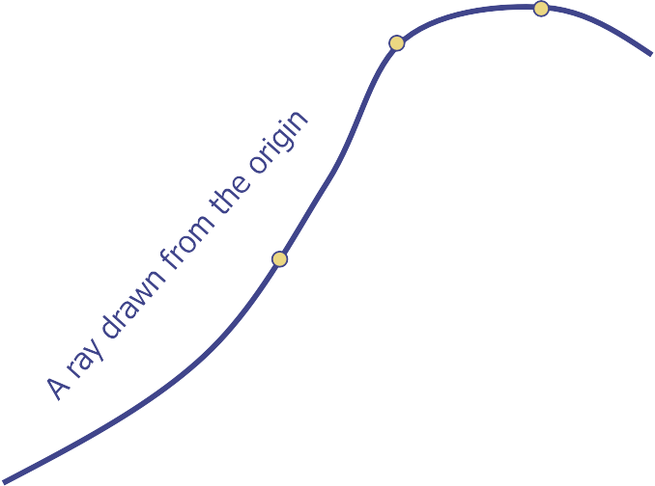
Relationships among Total, Marginal and Average Products of Labor
The law of variable proportions is used to explain the relationship between Total Product and Marginal Product. It states that when only one variable factor input is allowed to increase and all other inputs are kept constant, the following can be observed:
When the Marginal Product (MP) increases, the Total Product is also increasing at an increasing rate. This gives the Total product curve a convex shape in the beginning as variable factor inputs increase. This continues to the point where the MP curve reaches its maximum.
When the MP declines but remains positive, the Total Product is increasing but at a decreasing rate. Total product curve becomes a concave shape after the point of inflexion. This continues until the Total product curve reaches its maximum.
When the MP is declining and negative, the Total Product declines.
When the MP becomes zero, Total Product reaches its maximum.
C
TP
B
Total
product
A
A = inflection point
Labor
AP_{L}
A
MP_{L}
Marginal product
B
Average product
C
Labor
L_{A}
L_{B}
L_{C}

Slide 19
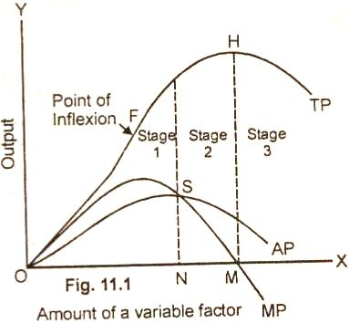
Relationship between Average Product and Marginal Product
Relationship between Average Product and Marginal Product can be summarize as :
When Average Product is rising, Marginal Product lies above Average Product.
When Average Product is declining, Marginal Product lies below Average Product.
At the maximum of Average Product, Marginal and Average Product equal each other.

Slide 20
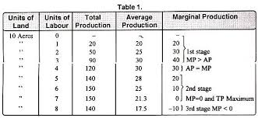
Table depicting stages of production

Slide 21
Law of Variable Proportions (additional)
Prof. Benham states the law as follows: “As the proportion of one factor in a combination of factors is increased after a point, the average and marginal production of that factor will diminish”.
G. J. Stigler: “As equal increments of one input are added, the inputs of other productive services being held constant, beyond a certain point the resulting increments of product will decrease, i.e. the marginal product will diminish.”
The law is summarised thus: In the short run, as the amount of variable factors increases, other things remaining equal, output (or the returns to the factors varied) will increase more than proportionately to the amount of variable inputs in the beginning, then it may increase in the same proportion and ultimately it will increase less proportionately”.
The conditions underlying the law are :
Only one factor is varied; all other factors remain constant.
The scale of output is unchanged and production capacity remains constant.
Technique of production is unchanged.
All units of factor input varied, are homogeneous – all units have identical efficiencies and characteristics.
All factors of production cannot be substituted for one another. Measurements of the Product

Slide 22
Total Product: Total number of units produced per unit of time by all factor inputs in referred to as total product.
In the short run, since Total Product (output)(TP) increases with an increase in the Quantity of Variable Factor (QVF), TP = f(QVF).
Average Product: Average Product refers to the total product per unit of the given variable factor. AP = TP/QVF
Marginal Product: Owing to the addition of a unit to a variable factor, all other factors being held constant, the additional realised in the total product is technically called marginal product.
MPn = TPn – TPn-1

Slide 23
Production Functions of two variable inputs
Main Concepts -The Main concepts of Production Functions are:
1. The marginal productivity of factors of production.
2. The marginal rate of technical substitution.
3. Elasticity of substitution
4. Factor intensity

Slide 24
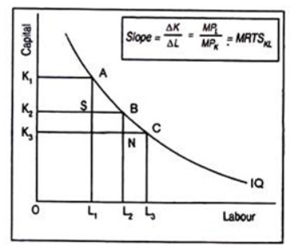
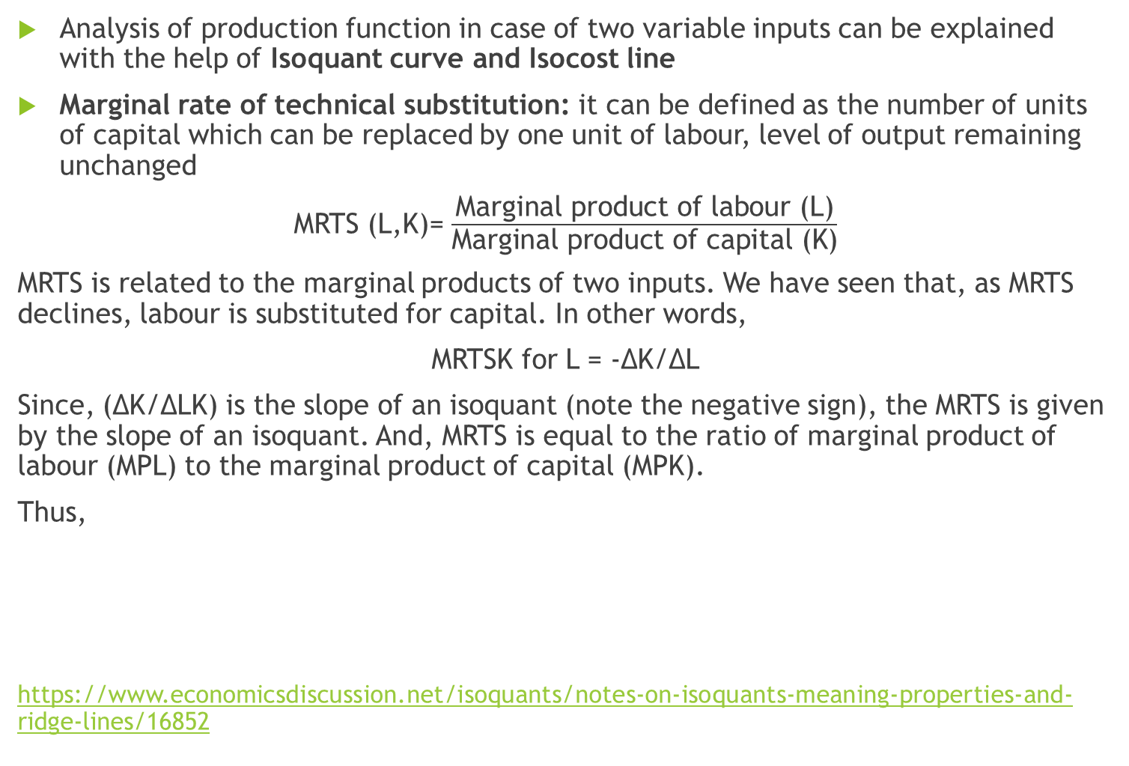
Production function with Two variable inputs (both capital (K) and Labour (L) are variable inputs
Analysis of production function in case of two variable inputs can be explained with the help of Isoquant curve and Isocost line
Marginal rate of technical substitution: it can be defined as the number of units of capital which can be replaced by one unit of labour, level of output remaining unchanged
MRTS (L,K)= $\frac{\text{Marginal} \text{product} \text{of} \text{labour}\text{ (}\text{L}\text{)}}{\text{Marginal} \text{product} \text{of} \text{capital}\text{ (}\text{K}\text{)}}$
MRTS is related to the marginal products of two inputs. We have seen that, as MRTS declines, labour is substituted for capital. In other words,
MRTSK for L = -∆K/∆L
Since, (∆K/∆LK) is the slope of an isoquant (note the negative sign), the MRTS is given by the slope of an isoquant. And, MRTS is equal to the ratio of marginal product of labour (MPL) to the marginal product of capital (MPK).
Thus,
https://www.economicsdiscussion.net/isoquants/notes-on-isoquants-meaning-properties-and-ridge-lines/16852

Slide 25
Isoquants
What are Isoquants?- ISO – means equal, QUANT – means quantity.
Isoquant literally means Equal Quantity.
Isoquant curve can also be called Iso-product curve. This curve represents equal quantity of output produced using various combinations of inputs.
An Isoquant is the locus of all the combinations of two factors of production that yield the same level of output.
Assumptions of Isoquants
1. It is generally assumed that there are only two factors or inputs of production.
2. The factors of production are divisible into small units and can be used in any proportion.
3. Technical conditions of production are given and cannot be changed.
4. Given the technical conditions of production, different factors are used in the most efficient manner.

Slide 26
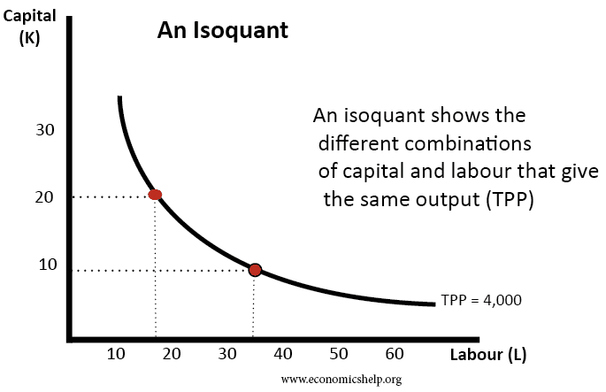
Isoquant Curve
Properties of Isoquants
1. Isoquants are negatively sloped i.e.,slope downward from left to right.
2. A higher Isoquant represents a larger output.
3. No two Isoquants intersect each other.
4. Isoquants are convex to the origin. - because the marginal rate of technical substitution tends to fall.
5. The rate at which one input is substituted for another is called the MRTS. The MRTS continuously declines. It is due to the diminishing MRTS an isoquant becomes convex to the origin.
6. Isoquants are parallel to each other.
7. No isoquant can touch either axis
8. Each isoquant is oval-shaped: This shape is a consequence of the fact that if a producer uses more of capital or more of labour or more of both than is necessary, the total product will eventually decline.
Thus, the firm will produce only in those segments of the isoquants which are convex to the origin and lie between the ridge lines. This is the economic region of production (explained later slides).

Slide 27
Types of Isoquants
Linear Isoquant
There is perfect substitutability of inputs.
Given output – say 100 units – can be produced by using only capital or only labour or by a number of combinations of labour and capital. – both are perfectly substitutable. •Given a power plant, equipped to use either oil or gas, various units of electric power can be produced by burning gas only, oil only or in varying combinations of each. Both gas and oil are perfect substitutes. Linear Isoquants Oil
Right angle Isoquant -Here there is complete non-substitutability between the inputs (strictly complimentary).
For example, exactly two wheels and one frame are required to produce a bicycle and wheels cannot be substituted for frames. •Similarly, two wheels and one chassis are required for a scooter. •This is also known as Leontief Isoquant. Right angle Isoquant Chassis
Convex Isoquant - This form assumes imperfect substitutability of inputs.
E.g. A shirt can be made with more wastage of cloth when less care (less labour) is used.(C1) •If more is spent on labour, the shirt can be made with less cloth, wastage being less.(C2)
If still more care is taken by spending more on labour, minimum wastage is done, by using still lesser amount of cloth.(C3) Convex Isoquant Cloth

Slide 28
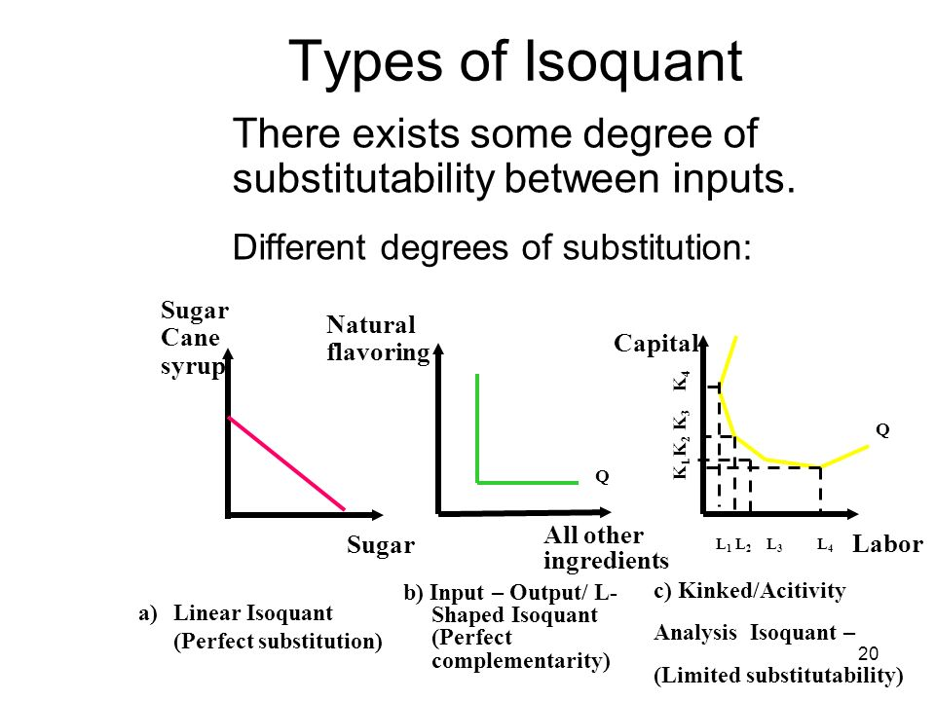

Slide 29
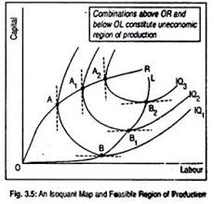
Economic Region of Production and Ridge Lines
Economic Region of production of an Isoquant is between the ridge lines.
Ridge lines: They are the locus of points of isoquants where the marginal products (MP) of factors are zero. The upper ridge line implies zero MP of capital and the lower ridge line implies zero MP of labour. Production techniques are only efficient inside the ridge lines.
Why MP of one factor is zero:
The marginal product of a particular factor may be negative if the quantity used is too large.
For example, if too much labour is used there may be congestion and the efficiency of all the labourers may be affected. An isoquant will include points denoting such factor quantities, because it includes all factor combinations producing the same output.
When relatively small amount of a factor is combined with relatively large amount of another factor in an iso-quant, in such a manner that the marginal productivity of this abundant factor tends to be negative, resulting in decline in total output.
In such cases, the end portions of the curves are regarded as uneconomical. Thus when extended on either side, the iso-quants are oval shaped.
Economic region of the iso-quant is determined by drawing tangents to the curves parallel to the two axes, and the points of tangency indicate zero marginal productivity of the abundant factor.
https://www.economicsdiscussion.net/production-function/ridge-lines-with-diagram-production-function-economics/25424

Slide 30
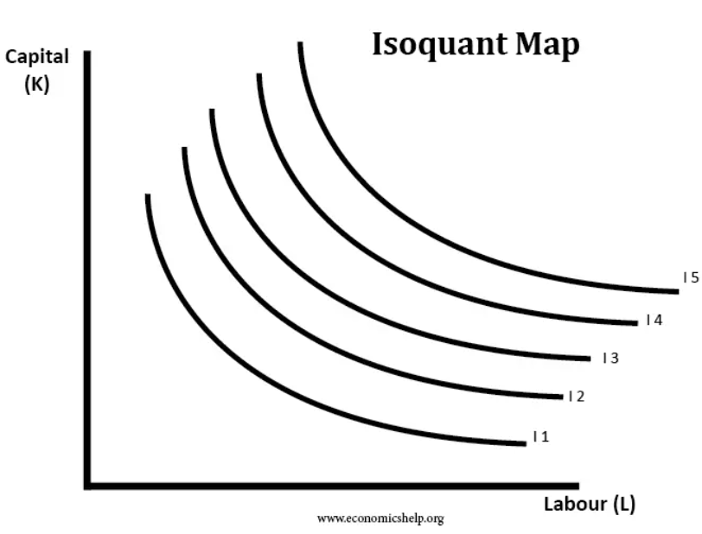
Isoquant Map
An isoquant map shows different levels of output.
An Iso-product map shows a set of iso-product curves. They are just like contour lines which show the different levels of output. A higher iso-product curve represents a higher level of output.
In the short-term, a firm faces a trade-off along one particular isoquant. But, in the long-term, a firm can invest in increasing capital stock and produce at a higher output for the same quantity of labour.
https://www.economicsdiscussion.net/iso-quant-curve/iso-quant-curve-definitions-assumptions-and-properties/6998

Slide 31
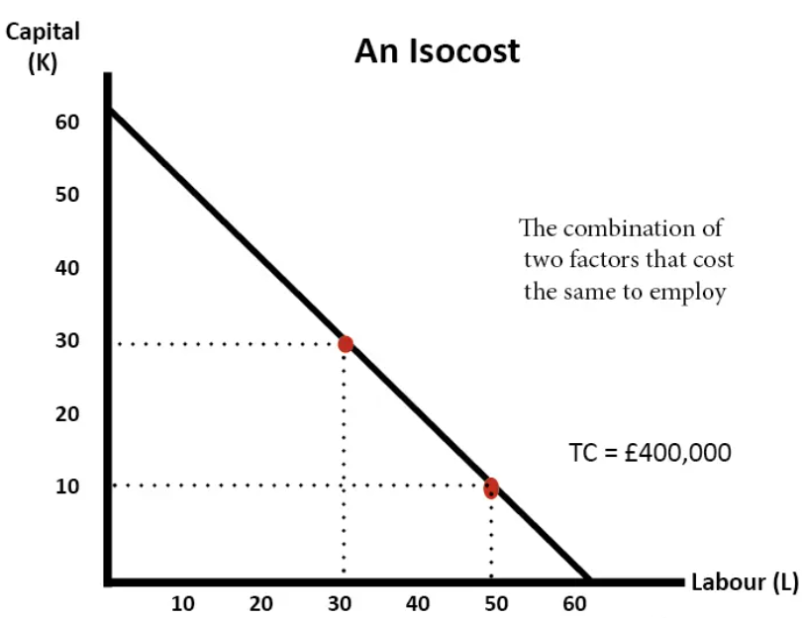
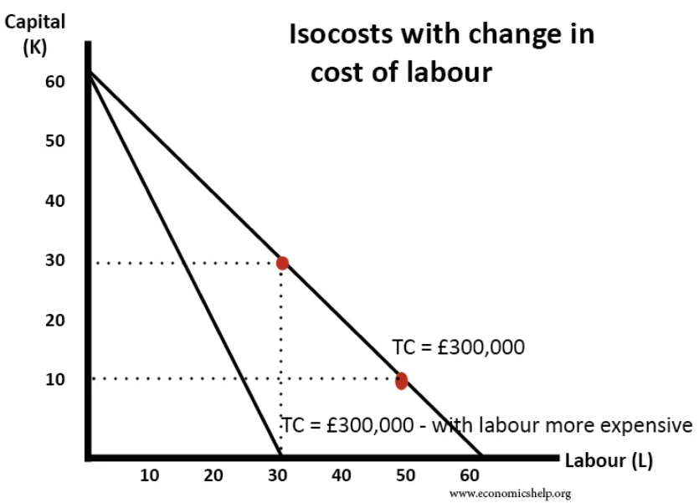
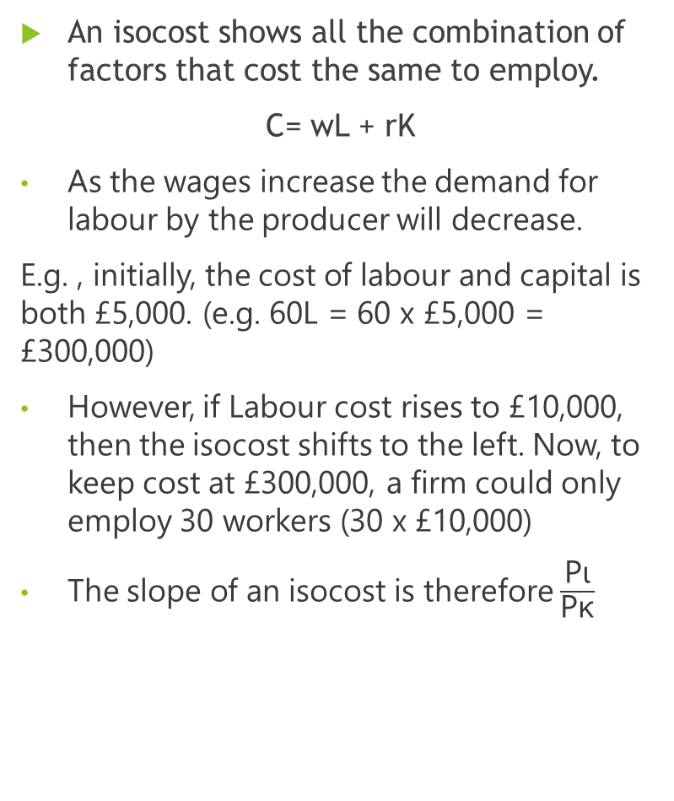
Isocost line
An isocost shows all the combination of factors that cost the same to employ.
C= wL + rK
As the wages increase the demand for labour by the producer will decrease.
E.g. , initially, the cost of labour and capital is both £5,000. (e.g. 60L = 60 x £5,000 = £300,000)
However, if Labour cost rises to £10,000, then the isocost shifts to the left. Now, to keep cost at £300,000, a firm could only employ 30 workers (30 x £10,000)
The slope of an isocost is therefore $\frac{\text{Pι}}{\text{Pκ}}$

Slide 32
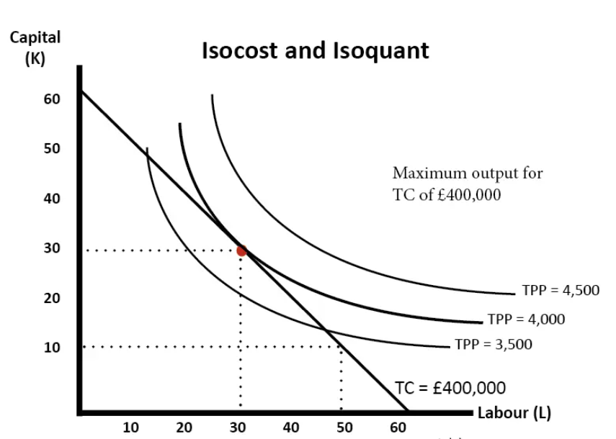
Profit maximisation and equilibrium
To maximise profits, a firm will wish to produce at the point of the highest possible isoquant and minimum possible isocost

Slide 33
THE LAWS OF RETURNS TO SCALE
Returns to scale: behaviour of output in response to change in scale. An increase in scale means that all inputs or factors used in production process are increased in same proportion.
Statement of the Law: “As a firm in the long run increases the quantities of all factors employed, other things being equal, the output may rise initially at a more rapid rate than the rate of increase in inputs, then output may increase in the same proportion of input, and ultimately, output increases less proportionately.”
Assumptions:
1.Technique of production is unchanged.
2.All units of factors are homogeneous.
3.Returns are measured in physical terms.
There are three phases of returns in the long run:
(1)The law of increasing returns
(2) The law of constant returns
(3) The law of diminishing returns.

Slide 34
The law of Increasing Returns
This law describes increasing returns to scale. There are increasing returns to scale when a given percentage increase in input will lead to a greater relative percentage increase in output.
When PFC (production factor coefficient) coefficient is > 1, it will be increasing returns to scale.
Law of Constant Returns
The process of increasing returns cannot go on for ever.
It is followed by constant returns to scale.
While expanding its scale of production, the firm gradually exhausts the economies responsible for increasing returns. Thereafter, constant returns occur.
When PFC coefficient is = 1, it will be constant returns to scale.

Slide 35
The Law of Decreasing Returns
As expansion is continued, growing diseconomies of factors are encountered.
When powerful diseconomies are met by feeble economies of certain factors, decreasing returns to scale results. This happens when PFC (production function coefficient) < 1.
Causes for decreasing returns:
1. Though all physical factors are increased proportionately, organization and management as a factor cannot be incresed in equal proportion.
2. Business risk increases more than proportionately when scale of production is enhanced. Entrepreneurial efficiency also has its limitations.
3. Growing diseconomies of large-scale production set in when scale of production increases beyond a limit.
4. Problem of supervision and coordination becomes complex and intractable in a large scale operation and becomes unwieldy to manage.
5. Imperfect substitutability of factors of production causes diseconomies resulting in a declining marginal output.

Slide 36
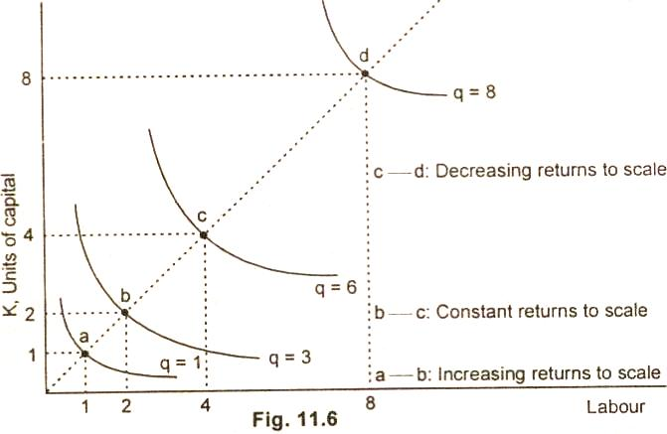
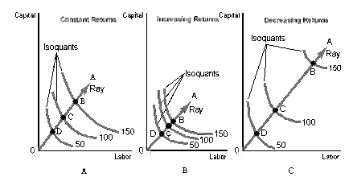
Graphical Representation of Returns to Scale
Constant returns to scale: Marginal returns (marginal physical product) of variable factors remains constant.
Decreasing returns to scale: Marginal returns (marginal physical product) of variable factors falls rapidly.
Increasing returns to scale: Marginal returns (marginal physical products) of variable factors increases

Slide 37
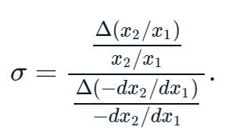
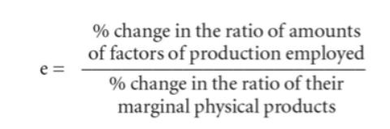
The returns to scale
Marginal Product of Factors -The marginal product of a factor of production is defined as a change in output due to a very small change in the quantity of this factor while quantities of all other factors of production remain constant. Marginal rate of technical substitution
The marginal rate of technical substitution of labour for capital is that quantity of capital which has to be reduced on an increase in the use of labour by one unit to keep the level of production constant.
The elasticity of technical substitution is defined as the percentage change in the ratio of the two factors of production (say, capital – labour ratio), divided by the percentage change in the marginal rate of technical substitution.
The factor intensity refers to capital-labour ratio. If K1/L1 > K2/L2 it shows that the former process is more capital intensive than the latter.
Commonly used General Production Function: X = f (L, K, v, u )
https://financial-dictionary.thefreedictionary.com/elasticity+of+technical+substitution

Slide 38
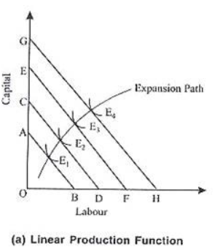
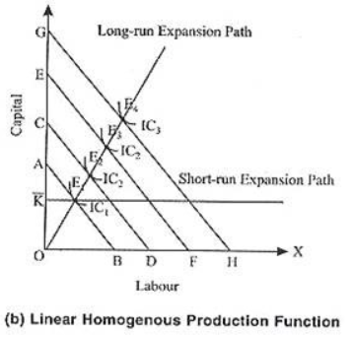
Expansion Path and Price Factor curve
An expansion path is a line connecting optimal input combinations as the scale of production expands
The producer aims to produce the output in the cheapest possible way attempts to increase production along the expansion path.
The expansion path may have different shapes and slopes depending upon the relative prices of the factors used and shape of the isoquant.
In case of constant returns to scale (homogenous production function), the expansion path will be a straight line through the origin, indicating constancy of the optimal proportion of the inputs of the firm, even with changes in the size of the firm’s input budget.
In short-run, however, the expansion path will be parallel to X-axis (when capital is hold constant at K.

Slide 39
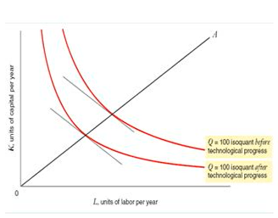
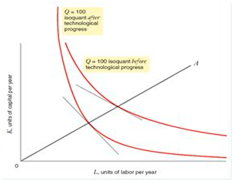
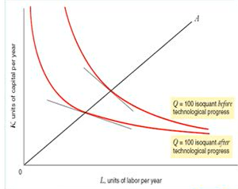
Expansion path and technical change
Technological change can be Input-neutral, capital saving (or labour intensive) and labour saving (or capital intensive)
Fig A: Input Neutral technological change. Ratio of labour and capital remains same
Fig B: Capital saving or Labour Intensive. Ratio changes it increases (L:K)
Fig C: Labour saving or capital intensive. Ratio decreases (L:K)
http://egyankosh.ac.in/bitstream/123456789/67484/1/Unit-7.pdf
Fig. A
Fig. C
Fig. B

Slide 40
Equal product curves relate to combinations between two factors of production.
Equal product curves can be labelled easily as physical units of output represented by it are measurable.
On equal product map, we can measure the exact difference between output represented by one iso-quant and another iso-quant.
Cobb-Douglas Production Function Cobb-Douglas production function relates output in American Manufacturing industries to labour and capital inputs, taking the form P = a(LbC1-b) …a and b are +ve constants.
P = total output (production) L = index of labour employed in manufacturing C = index of fixed capital in manufacturing b and 1-b are elasticities of production representing percentage response of output to percentage changes in labour and capital.
The above stated production function is a linear and homogeneous function of degree, one which establishes constant returns to scale.
Price factor curve: A change in the price of one of the factors will change the steepness of the curve, and thus changing the intercept with the isoquant. The firm will now have to produce at a new output level.

